Slide 1
Microsoft Excel
Thomas Ossa
Tech 101 Instructor Extraordinaire
(845) 877-7333 xt. 4
tossa@rboces.org
Oct 18 to Dec 13, 2016

Slide 2
Course Curriculum - Proposed
Oct 18 – Introduction, learn the basics, general housekeeping
Oct 25 – Introduce course plan, review, find / replace, sorting & filtering, formulas
Nov 1 –
Nov 8 –
Nov 15 –
Nov 22 – Test
Dec 6 – Group project
Dec 13 – Group project
You Decide.

Slide 3
Class 1
Start computer
Open up Excel
Learn the features of Excel 2013
To reach me:
Rockland Web Design (845) 877-7333 xt. 1 (Ask for me or Heather)
tossa@rboces.org

Slide 4
Start up computer
Push the Power Button on bottom right of monitor
Sign in with:
  User name: a# (Example – a2, a3, a4, a5, etc. (Please don’t use a2))
  Password: student (All lowercase)
New start menu:
  Bottom left side, click with mouse – will take you to new start screen
  To go back, bring mouse back to bottom left side and click again (Desktop)
In Start Screen, click on Microsoft Excel

Slide 5
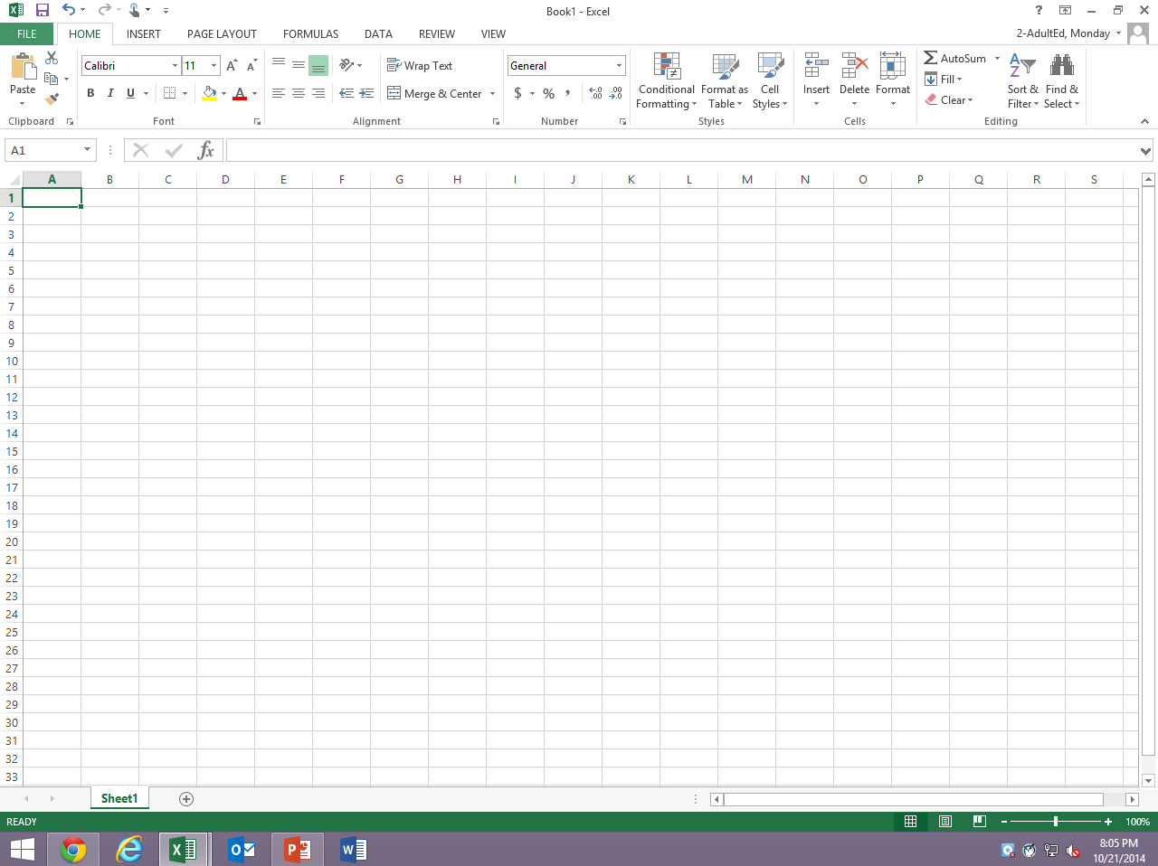
Excel Layout of Main Screen
Middle area is called the “grid”
Bottom area is called status bar
Top area is called “The Ribbon”
  Main tabs are:
    Home
    Formulas
    Data

Slide 6
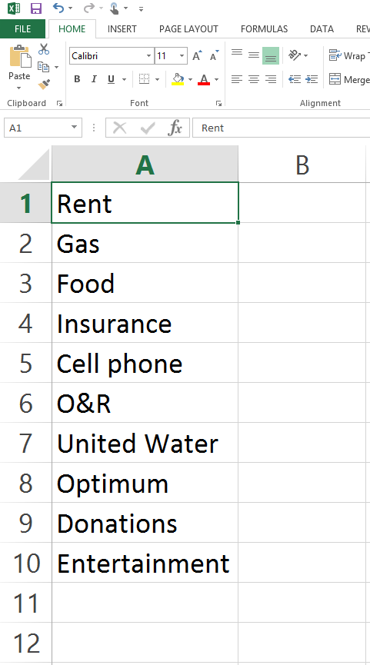
Cell
Basic building block of an Excel spreadsheet
Each spreadsheet can hold hundreds of thousands of cells
Cells can hold three different types of information:
  Text
  Numbers
  Formulas
    Examples of formulas include:
      SUM ( )
      AVERAGE ( )
      MIN ( )
      MAX ( )
      IF ( )
    Three parts of function formula
      = Sign
      Function name
      Argument

Slide 7
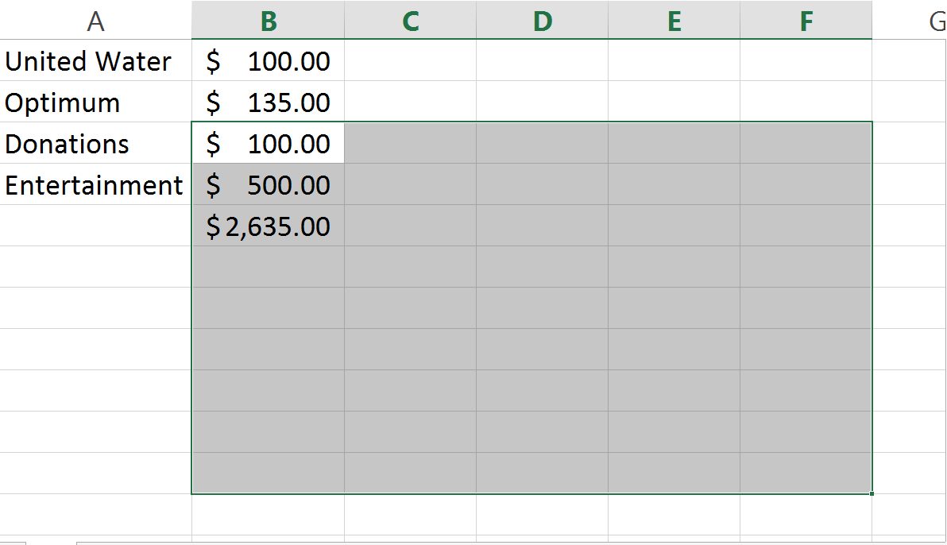
Range
Group of cells identified by two addresses:
  Top-left cell
  Bottom-right cell
Example: Range B12:F20

Slide 8
Range Example Goodness
B3:F11
G10:J14
A3:F5
C4:H5

Slide 9
Saving Your Document
CTRL + [S]
…or the top left hand corner there is a [Save] icon
…or Click on [File] >> Save As

Slide 10
Navigating Around the Spreadsheet
Arrow keys: Up, Down, Left, Right. Duh.
Enter: Down
Tab: Right
Shift and Enter: Up
Shift and Tab: Left
Mouse: Left - click on any cell once to select it, twice to edit it

Slide 11
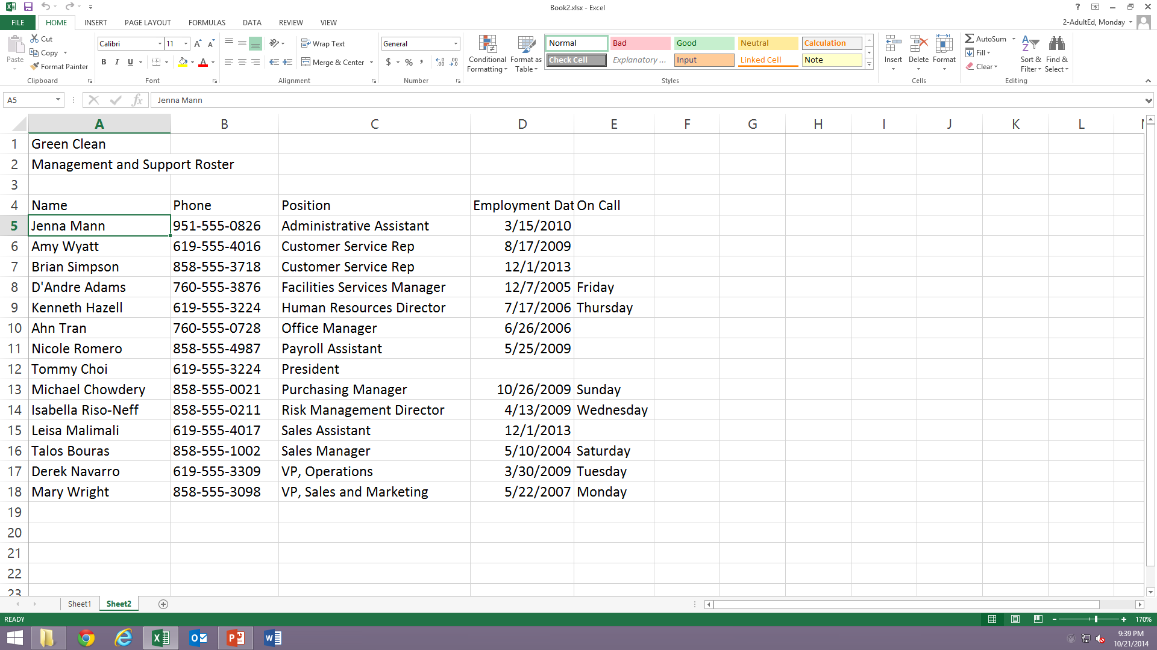
Exercise: EXO2.2

Slide 12
Class 2
Introduce course curriculum
Review last week
Messing around with the stuff in the boxes:
  Cut
  Copy
  Paste
  Shortcut keys
  Autofill
  AutoComplete
Sorting & filtering
Find / replace
Formulas
Basic formula structure
FOR NEXT WEEK: TOTALLING BY CLASSES. COOLNESS.
Class Rosters

Slide 13
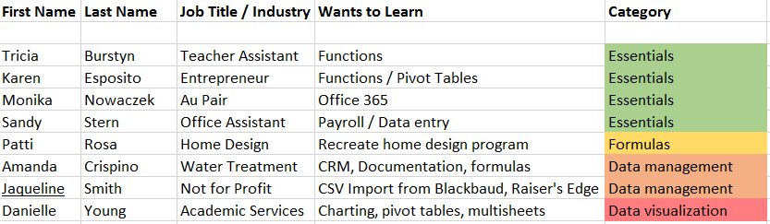
From Your Notes Last Week:

Slide 14
Course Curriculum - Proposed
Oct 18 – Introduction, learn the basics, general housekeeping DONE
Oct 25 – Introduce course plan, review, find / replace, sorting & filtering, formulas | Class Rosters
Nov 1 – Chapter 3: Formulas , Editing worksheet appearance, percentages, IF( ) Statement | Budgeting
Nov 8 – Chapter 4: Absolute cell references, IF( ) Statement, review stuff and vLookup | Financial Data
Nov 15 – Chapter 5: Test, Formatting spreadsheets
Nov 22 – Chapter 6: Working with Data - Charts, Graphs and Embedding | Mail Merge
Dec 6 – Pivot tables, group workshop #1 & additional items
Dec 13 – Final class

Slide 15
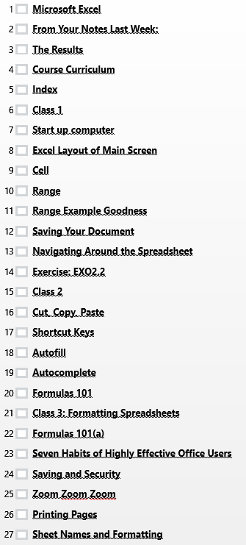
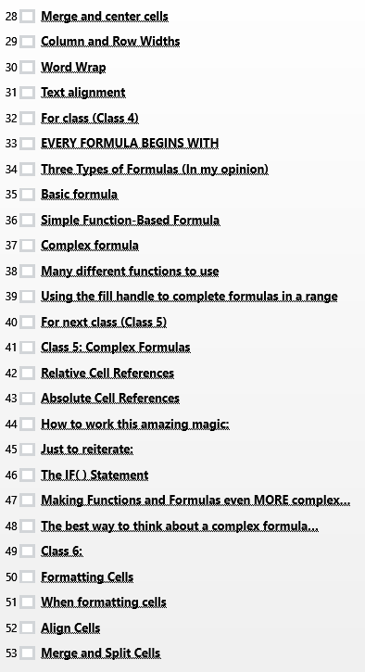
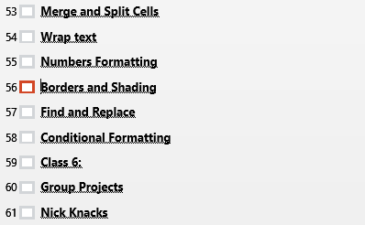
Index
Note:
Order to be modified in coming weeks.

Slide 16
Cut, Copy, Paste
Allows you to move or duplicate information very quickly from one location of the spreadsheet to another.
To use:
  Highlight cells
  Right click (or use shortcut keys)
    Cut (CTRL + x)
    Copy (CTRL + C)
  Move to new location of spreadsheet
  Right click (or use shortcut keys)
    Paste (CTRL + V)

Slide 17
WIFI: 22234362

Slide 18
Shortcut Keys
[CTRL] + [Z] – Undo
[CTRL] + [X] – Cut
[CTRL] + [C] – Copy
[CTRL] + [V] – Paste
[CTRL] + [S] - Save
[ALT] + [TAB] – Toggle between open programs
[Windows] + [D] – Minimize all Windows, go back to Desktop
[CTRL] + [N] – New spreadsheet
[CTRL] + [O] – Open an existing spreadsheet

Slide 19
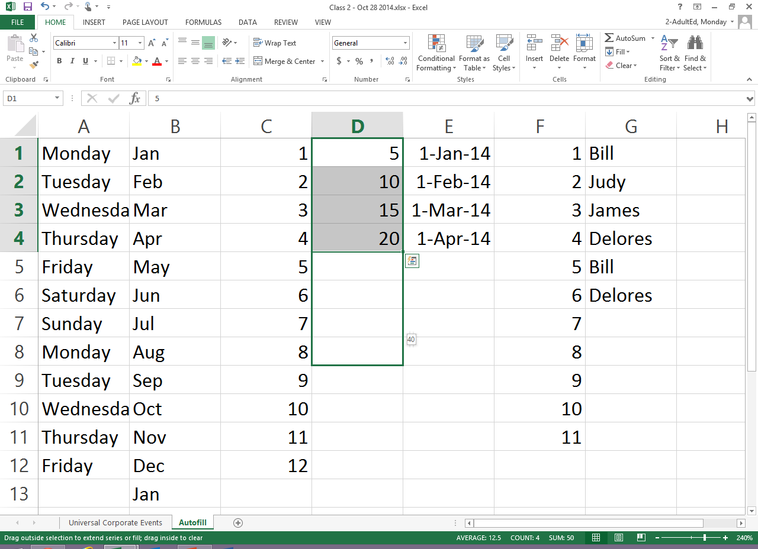
Autofill
Useful feature in Excel that allows you to quickly fill in patterns of data.
Examples:
  Monday, Tuesday, Wednesday
  Mon, Tues, Wed
  Jan, Feb, Mar
  January, February, March
  1, 2, 3
  10, 20, 30
  7, 14, 21
  5, 10, 8, 13, 18, 16
To use: Highlight a range
Click and hold little dot, bottom right.
Drag down or to the right.

Slide 20
Autocomplete
When you type in an entry, Excel remembers that entry
When you type a few letters of that entry again, Excel will fill in the rest
  Example:
    Type “Billy Bob”
    Type “Bill” again – Excel will add in “…y bob”

Slide 21
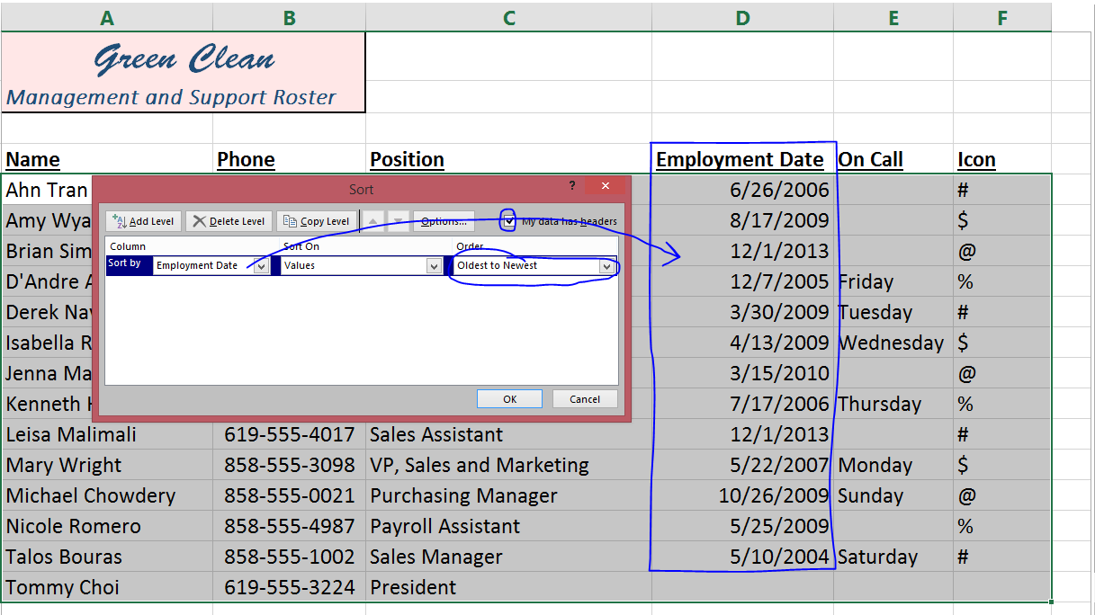
Sorting Data
Highlight the entire data set of
cells you want to sort, including
headings
On the ribbon, go to
[Data] >> [Sort]
Choose “My data has headers”
Choose the column by which
you want to sort
Choose the value type
(Likely values)
Choose the order to sort
(A-Z, Z-A, Lowest to highest, etc.
Click [OK]

Slide 22
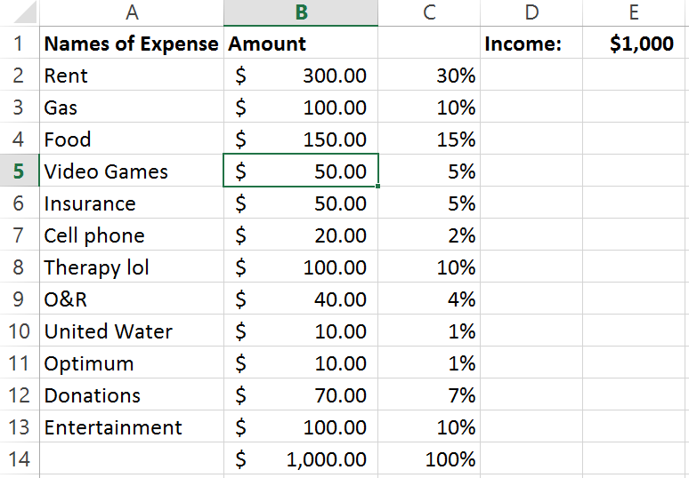
Budget Spreadsheet

Slide 23
Class 3: All About Formulae
Try to set up the spreadsheet on EX04.2 without any formulas in it.
(Use the force, Luke.)
Easy creation of formulas with AUTOSUM
Concepts:
  Every formula begins with = sign
Budgeting

Slide 24
Budget Spreadsheet

Slide 25
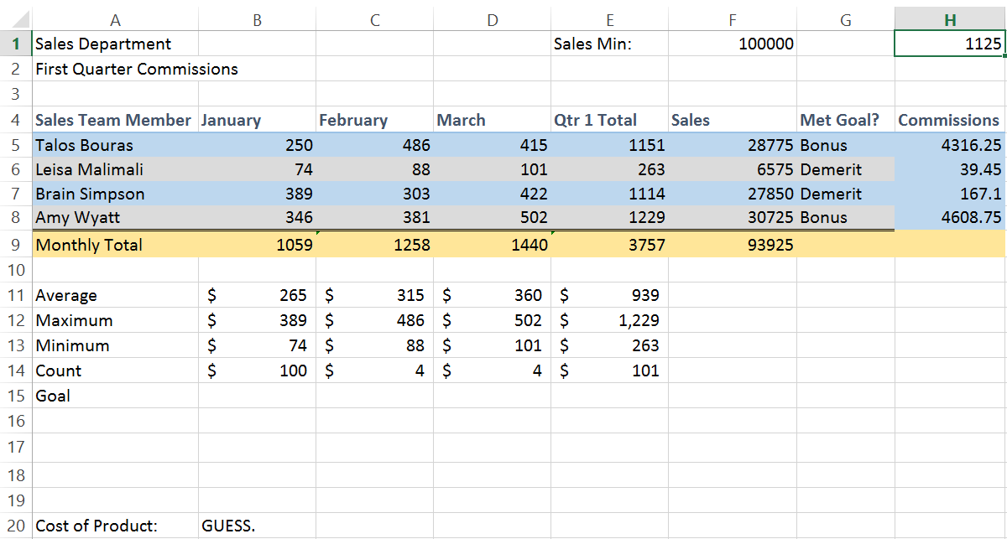
Create this Spreadsheet

Slide 26
EVERY FORMULA BEGINS WITH
=

Slide 27
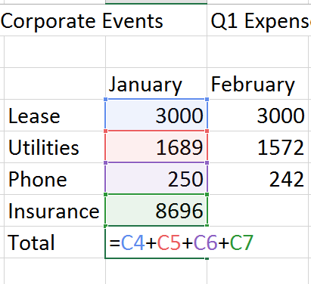
Formulas 101
Formula is simply a way to calculate a result automatically
EVERY FORMULA BEGINS WITH AN = SIGN
Basic formula structure:
  = sign
  Values (Numbers, Cell references, Text, dates, whatever)
  Operators (+, -, x, /)SC
  Functions (SUM, AVERAGE, MIN, MAX…)
Simplest formula is to type in “= A1 + A2 + A3” <Enter>
Yes, it’s annoying. But if you learn this you understand the
basic formula structure. So ha!

Slide 28
Formulas 101(a)
Every formula begins with an _________________
Basic formula structure:
If your formula happens to deal with an empty cell, you should ________
If you are going for speed:
  Left hand should be on _______________
  Right hand should be on ______________
Number of times that you will likely type in cell addresses after this class: ___

Slide 29
Three Types of Formulas (In my opinion)
Basic formula: Simply adding up cells
  Example: =A1+A2
  Example: =A1+A2+A3
  Example: =C5+D12+A9+F10
Function-based formula: Uses a “function” to perform a complex operation
  Example: =SUM(A1:A12)
  Example: =AVERAGE(B10:F20)
  Example: =COUNT(C3:C17)
Complex Formula: Mixes it all together
  Example: =AVERAGE(B10:F20)+A1-C5*SUM(A1:A12)

Slide 30
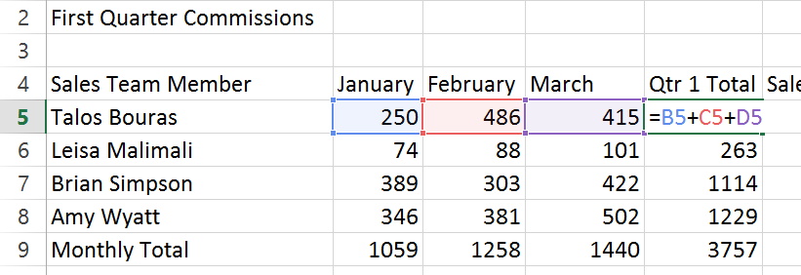
Basic formula
Start with an = sign
Use right hand to click on a cell that you want in the formula
Use left hand to choose an operator, such as [+], or [-], or [*]
Repeat as needed to include all cells in formula
Press [Enter] when done
      =A1+A2+A3

Slide 31
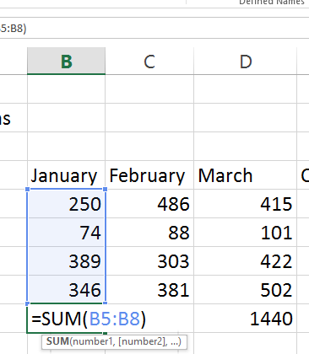
Simple Function-Based Formula
Start with an = sign
Type in the name of the function (Examples: SUM, or MIN, or AVERAGE)
Open a ‘(‘ parentheses using [Shift] and the number [9].
Use right hand to highlight the cells that you want in the formula
Close the bubble with a ‘)‘ parentheses using [Shift] and the number [0].
Press [Enter] when done
=SUM(A1:A3)

Slide 32
Complex formula
We’ll get to that.
]-)

Slide 33
Other stuff that isn’t as important, but happens to be in the book lol

Slide 34
Seven Habits of Highly Effective Office Users
Start a document (New / Open)
Save the document
Setup the document
Just type, dammit.
Proofreading: Format, Edit, Check text and numbers
Save and print
Close

Slide 35
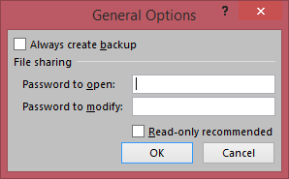
Saving and Security
When you save a document, there is a way to add a password, to prevent people from changing it.
  As normal, click on [Save As]
  Go to the folder / location you want to save the document
  At the bottom of the window, choose [Tools] >> [General Options]
  Add a password
  Remember it. Lol
  Save
When you open the document the next time, you’ll be asked for a password.

Slide 36
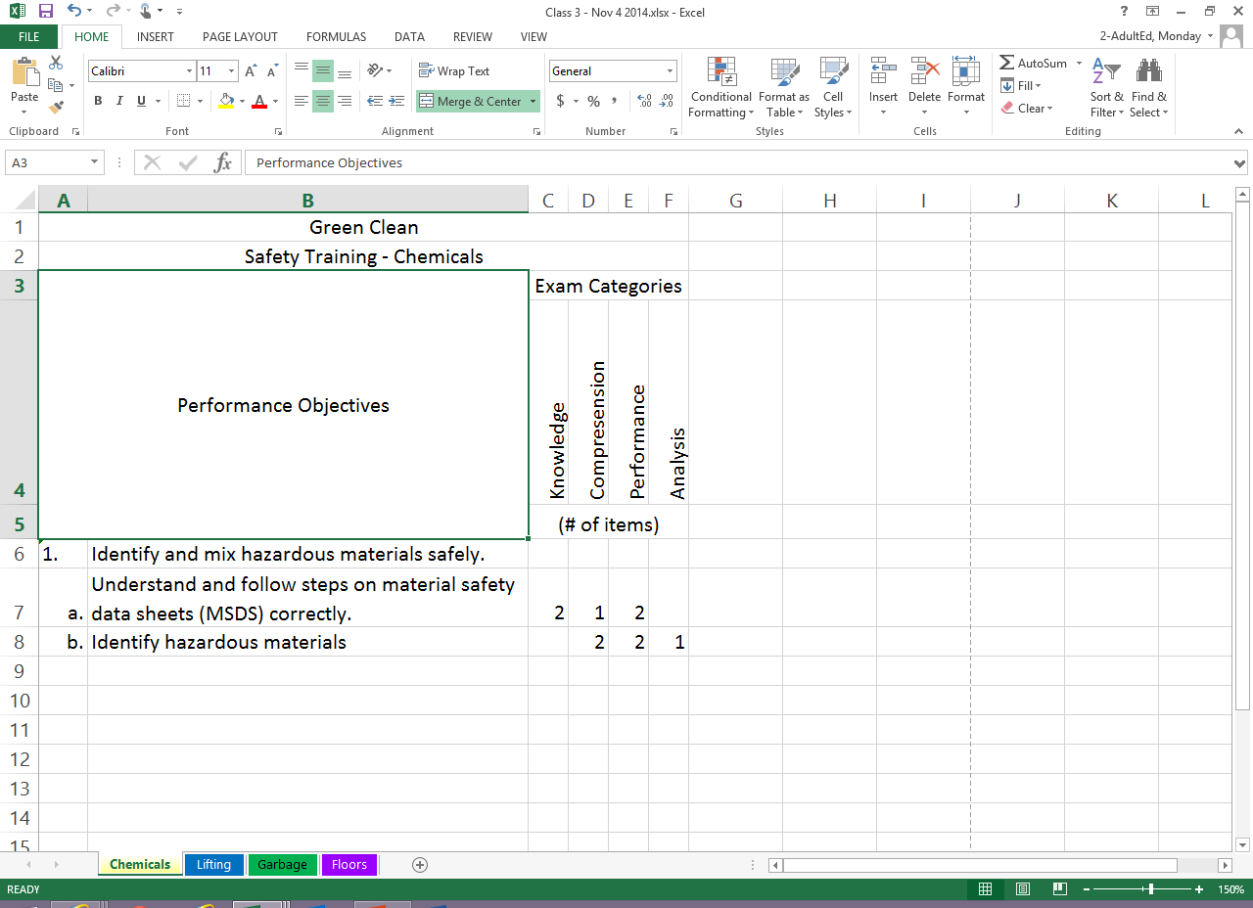
Zoom Zoom Zoom
Pretty simple thing, but when you are saving the spreadsheet, make sure you are zooming to the correct size, especially for the person that will be opening the document. Hello, customer service!

Slide 37
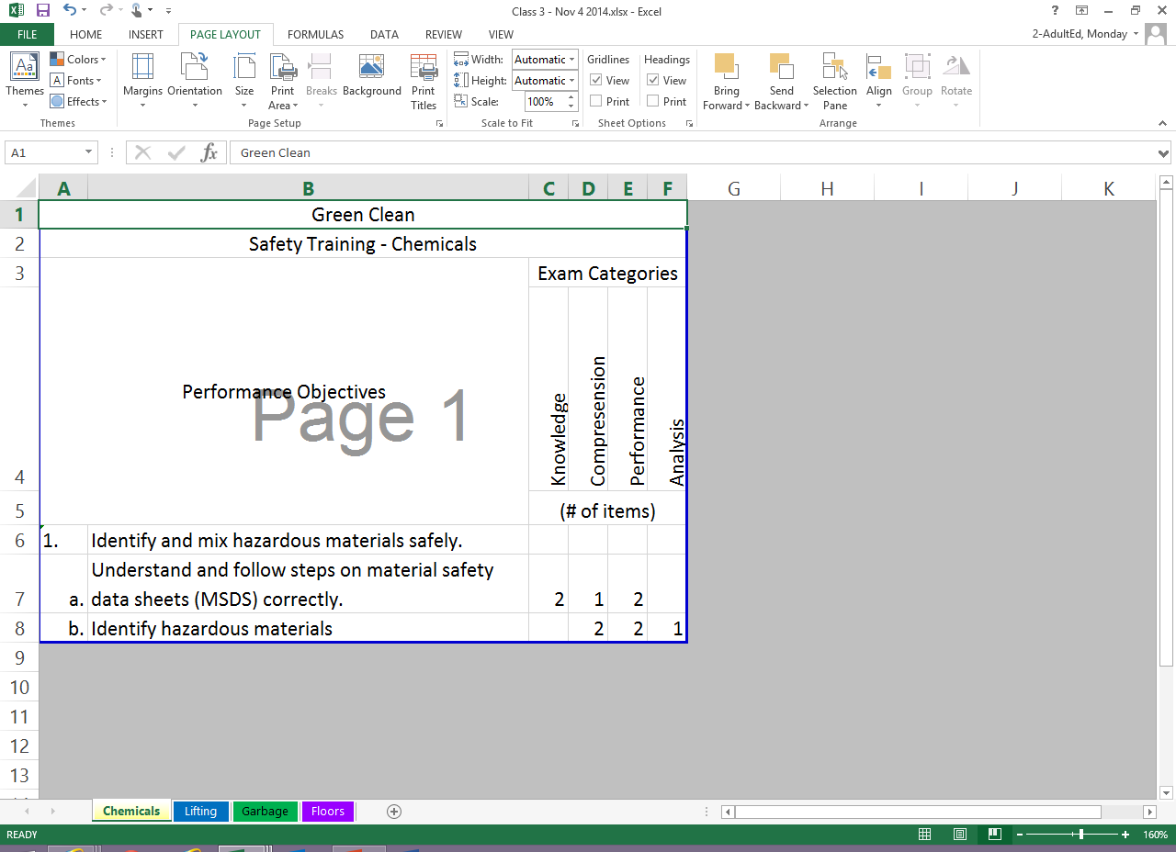
Printing Pages
Standard thing to do is to go to [File] >> [Print], and print up as many pages as you need.
However, if you need to change the print area of your document, you can go to the [Print Area] function on the status bar, and set the area that will print.

Slide 38
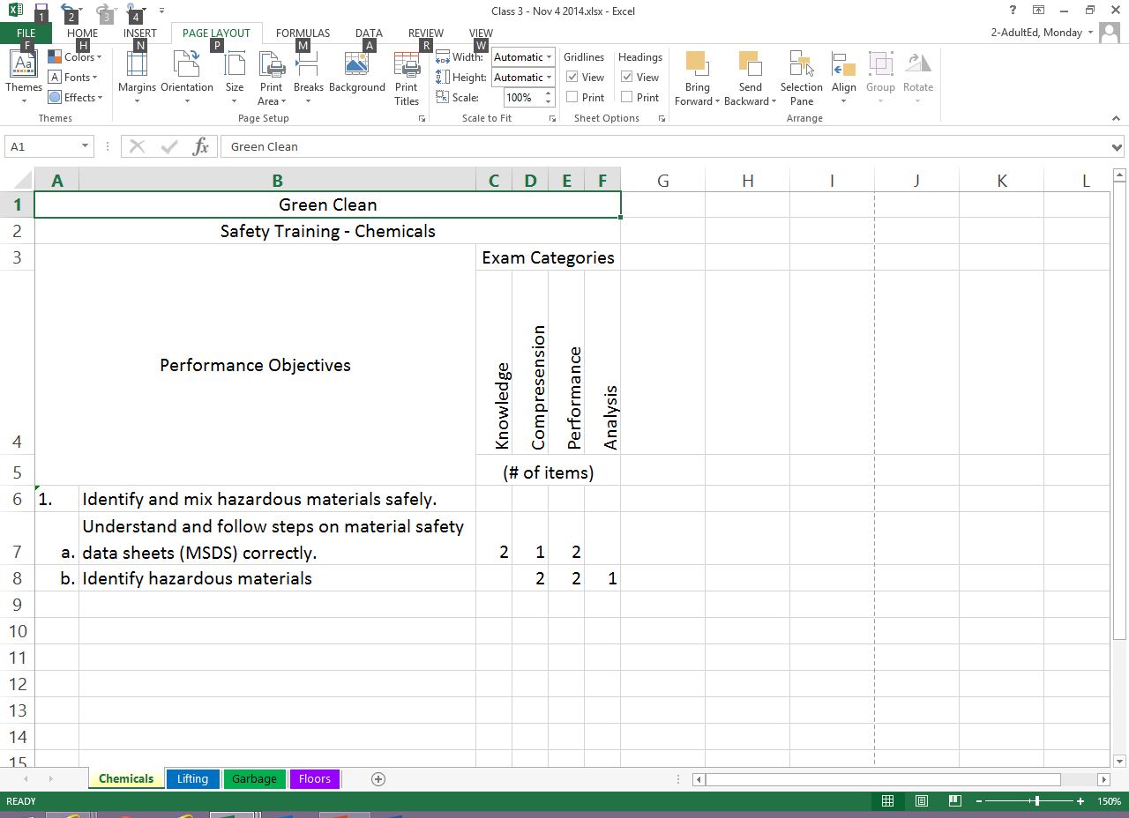
Sheet Names and Formatting
Right clicking on each sheet gives you a bunch of options:
  You can name each individual sheet anything that you want it to be named.
  You can also color code the sheets
  You can also hide sheets
  Any sheets that are hidden can also be unhidden
Every time you click on the [+] button, you add an additional sheet
To move a sheet, simply click and hold it, and drag to the left or the right

Slide 39
Merge and center cells
Highlight whatever cells you want to merge
Go to [Home] >> [Merge and Center]
The cells will merge. And center. W00T!

Slide 40
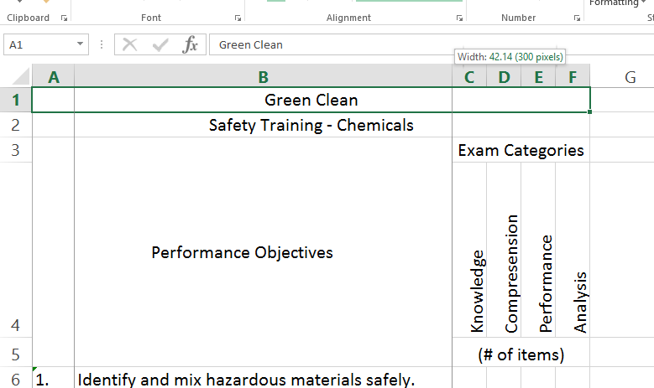
Column and Row Widths
Change column and row widths simply by clicking and holding in between each column, and dragging to the left, right, up or down.
You can also drag multiple columns or rows at the same time by first highlighting all of them.

Slide 41
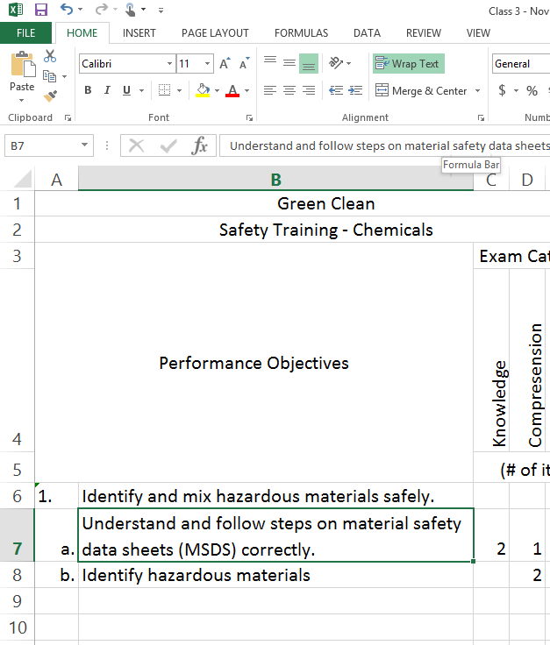
Word Wrap
To ensure all text appears in a given cell, click on the cell that you want the text to appear in full, and click on [Home] >> [Wrap Text]

Slide 42
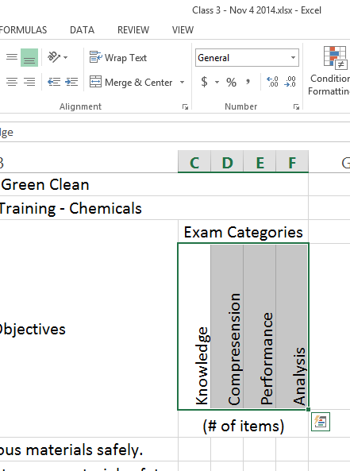
Text alignment
Highlight any cell in which you want text to look differently
Click on [Home] [Text Orientation] button
Change the alignment, orientation, angle of text in the cell

Slide 43
Class 4a
Try to set up the spreadsheet on EX03.2 without any text in it.
(Use the force, Luke.)
Format the cells as shown in the book.
Also, please read chapter 3, and if you want to get a head start, read chapter 4.
No classes on Veterans Day, Nov 11. Enjoy your week off!
Financial Data

Slide 44
Three Types of Formulas (In my opinion)
Basic formula: Simply adding up cells
  Example: =A1+A2
  Example: =A1+A2+A3
  Example: =C5+D12+A9+F10
Function-based formula: Uses a “function” to perform a complex operation
  Example: =SUM(A1:A12)
  Example: =AVERAGE(B10:F20)
  Example: =COUNT(C3:C17)
Complex Formula: Mixes it all together
  Example: =AVERAGE(B10:F20)+A1-C5*SUM(A1:A12)

Slide 45
Basic formula
Start with an = sign
Use right hand to click on a cell that you want in the formula
Use left hand to choose an operator, such as [+], or [-], or [*]
Repeat as needed to include all cells in formula
Press [Enter] when done
      =A1+A2+A3

Slide 46
Simple Function-Based Formula
Start with an = sign
Type in the name of the function (Examples: SUM, or MIN, or AVERAGE)
Open a ‘(‘ parentheses using [Shift] and the number [9].
Use right hand to highlight the cells that you want in the formula
Close the bubble with a ‘)‘ parentheses using [Shift] and the number [0].
Press [Enter] when done
=SUM(A1:A3)

Slide 47
Complex formula
We’ll get to that.
]-)

Slide 48
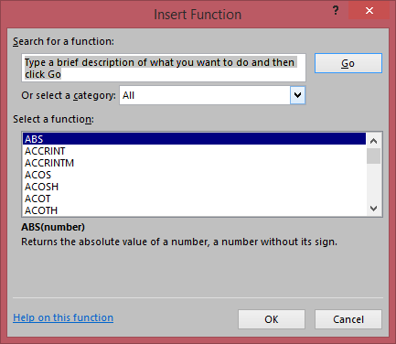
Many different functions to use
On the menu bar, go to [Formulas] and the [Insert Function] button on the ribbon
You will see over 200 different formulas (formulae?) available for use
To learn what each one does with examples,
Google “Excel [Name of Function]”
The ones we often use in this class are:
  SUM( ) – Adds stuff up.
  AVERAGE( ) – Finds average number of a range of cells
  MIN( ) – Finds lowest number in a range of cells
  MAX( ) – Finds highest number in a range of cells
  COUNT( ) – Finds total number of cells in a range that have a number in them
  IF( ) – Performs an action or a calculation based on a certain condition

Slide 49
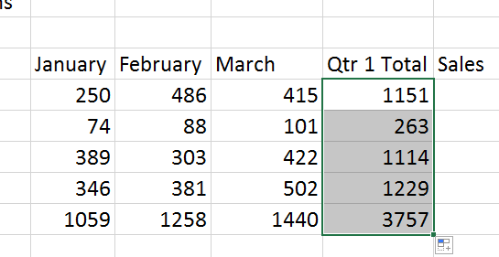
Using the fill handle to complete formulas in a range
Create your formula in the first cell
Make sure it is correctly written
Make sure again that it is correctly written
See above.
Ok…now click on the little dot in the corner of the cell with the function in it…
And drag it down, or to the right, or wherever to copy the formula all the way down.
IMPORTANT: This only works if the data and the formulas are all correctly laid out in a nice pattern.

Slide 50
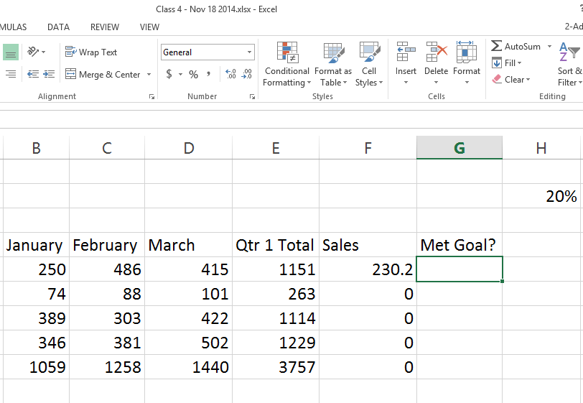
For next class (Class 5)
We will start off with the problem of percentage of sales not fill handling…Nov 18 sheet
Small test is a-coming…
Please read through Chapter 4. We will still be
in it next week.

Slide 51
Class 4: Complex Formulas
Review
  Three types of formulas: Simple, Function-Based and Complex
  Every formula begins with an = sign
  Functions: Sum( ), Average( ), Max( ), Min( ), Count( )
  Autofunction vs. writing out the formula
  Using fill handle – benefits and dangers
Pickup from last week:
  Why?
  ACR and practice
  The IF( ) Statement
Break
Test
Mail Merge

Slide 52
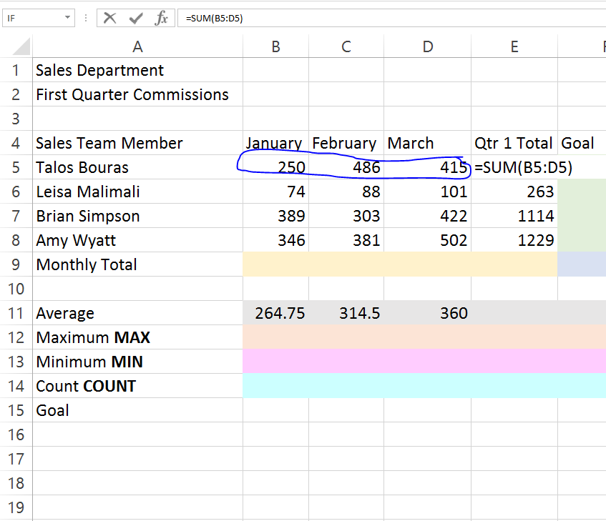
Relative Cell References
Relative cell reference:
If you move a formula, the cells that are
referenced in the formula move along with it.
Example:
The cell to the right, E5, is adding up
cells B5:D5.
If we copied that formula down to cell E6, the
cells referenced would be B6:E6.

Slide 53
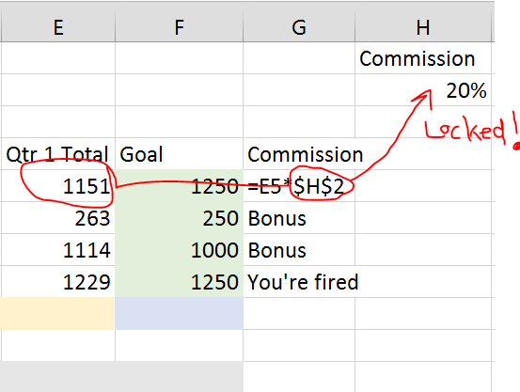
Absolute Cell References
If you move a formula, the cells that are
referenced in the formula move along with it.
Example:
Same example as before: the cell to the right,
E5, is adding up cells B5:D5.
However, since cell H2 is referred as an absolute
cell reference, if we copy the formula
down to cell E6, the cells referenced would be:
For formula in G6 >> B6:E6
For formula in G7 >> B7:E7
For formula in G8 >> B8:E8
For formula in G9 >> B9:E9

Slide 54
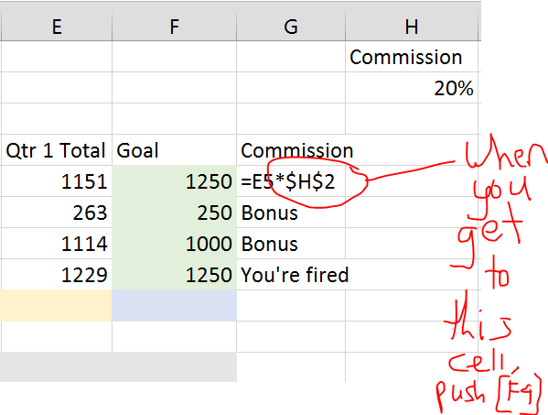
How to work this amazing magic:
When referring to a particular cell that you want to lock:
  Create the formula as usual, except…
  When you get to the cell that you want to lock:
    Click on the cell, or type it in the formula
    Push the [F4] button on your keyboard
    You’ll see dollar signs next to the cell in the formula
    Continue and complete the formula
You can now copy this formula wherever you need.

Slide 55
Just to reiterate:
F4
…creates an absolute cell reference.

Slide 56
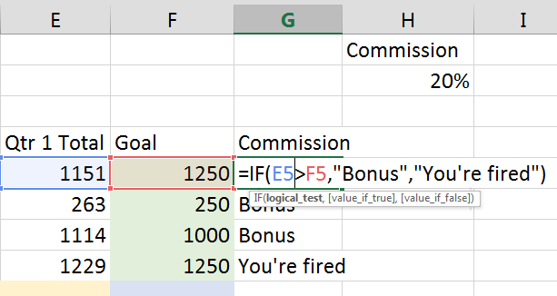
The IF( ) Statement
A function that performs an action (or calculation) based on a certain logical condition
This logical condition (or logical test) that you create can only be TRUE or FALSE
The three parts of an IF( ) Statement are:
  Logical test
  Value if true
  Value if false
The three parts are each separated by a comma:
=IF (Logical test, Value if true, Value if False)

Slide 57
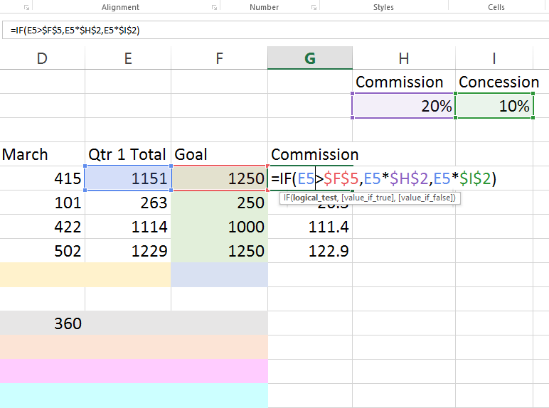
Making Functions and Formulas even MORE complex…
Within each part of a complex formula, such as the
IF( ) statement, you can create another
mini formula to conduct a calculation.
For example:
  Let’s say the logical criteria is IF E5 is greater than F5
  In the Value if true area, we can create a formula
  that multiplies a total by 20%.
  In the value if false area, we can create a formula
  that multiplies the total by 10%.

Slide 58
The best way to think about a complex formula…
Imagine that within that IF( ) statement,
it is actually three separate formulas:
  The logical test: E5>$F$5
  The value if true: E5*$H$2
  The value if false: E5*$I$2
Treat them as separate formulas as you are
building them
  Then, you simply combine them in the
  IF( ) statement, and separate each area inside the
  argument with a comma:
  =IF(E5>$F$5, E5*$H$2, E5*$I$2)

Slide 59
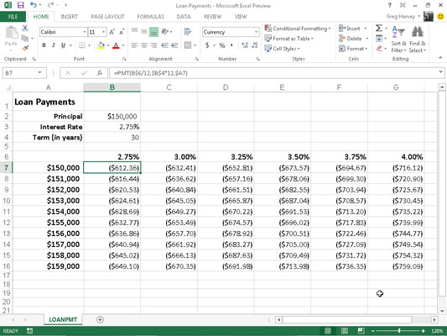
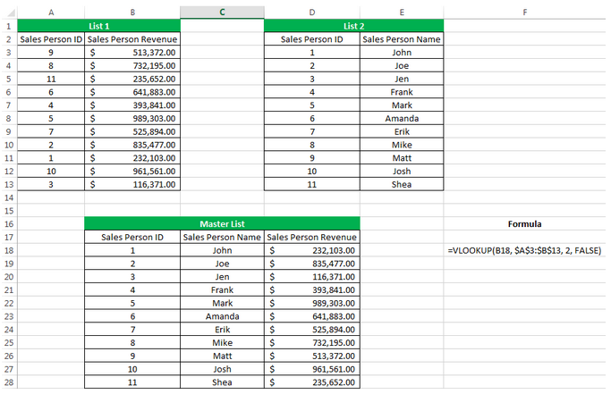
Other Really Cool Formulae
Count( ) and Counta( ) – Counts numbers of un-empty cells
Len( ) – Counts number of characters in a cell
Trim( ) remove extra spaces
SumIf( )
CountIf( )
AverageIF( )
VLOOKUP( )
Concatenate( ) – Combine contents of several cells
PMT( ) Function (Source here)
Source: Udemy and ExcelIntern.com

Slide 60
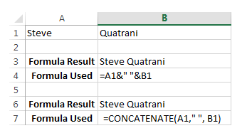
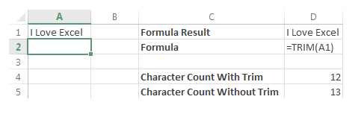
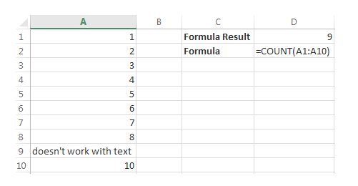
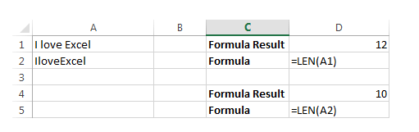
Trim( )
Concatenate( )
Count & CountA( )
Len( )

Slide 61
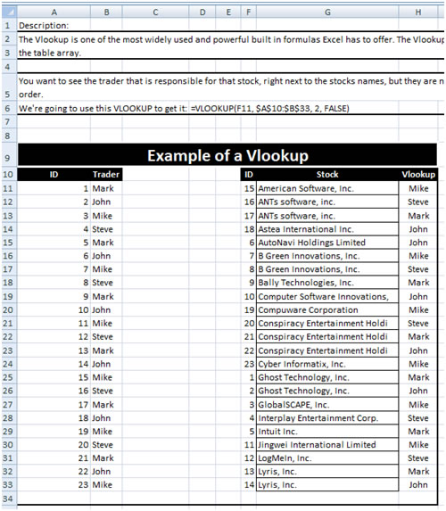
VlOOKUP( )

Slide 62
VLOOKUP( )

Slide 63
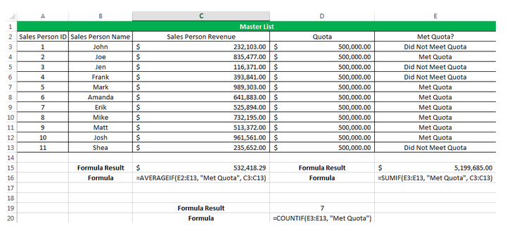
SUMIF( ), AVERAGEIF( ), COUNTIF( )

Slide 64
Class 5:
Read chapter 5
Choose exercises
Remember bottom of ex04.
Review of the test-quiz
Review of If( ) statement
Begin chapter 5
Group exercise
Pending exercise

Slide 65
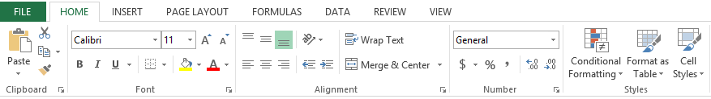
Formatting Cells
All the formatting actions are located on one ribbon tab: HOME.

Slide 66
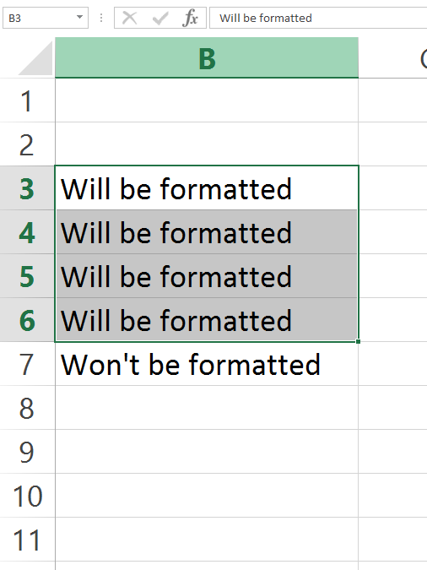
When formatting cells
Make sure you have already selected the cells
you want to format, with your mouse.

Slide 67
Align Cells
Left
Center
Right
Top
Bottom
Middle

Slide 68
Merge and Split Cells
Merge: Combine several cells together
Split: Um, split those cells up back to the way they were before

Slide 69
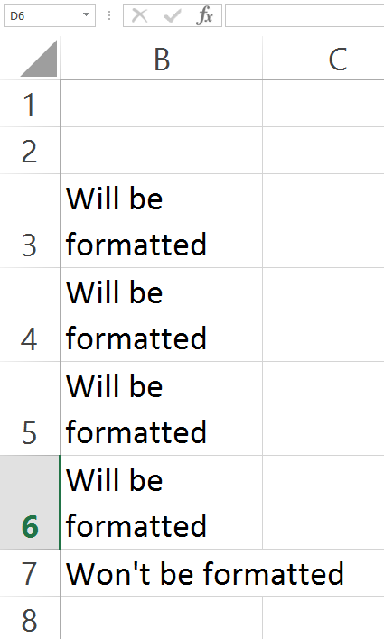
Wrap text
Make sure all contents of cell show up
Note: If it doesn’t work, try increasing column size or decreasing it

Slide 70
Numbers Formatting
Set numbers to show up like currency, decimals, negatives, etc.

Slide 71
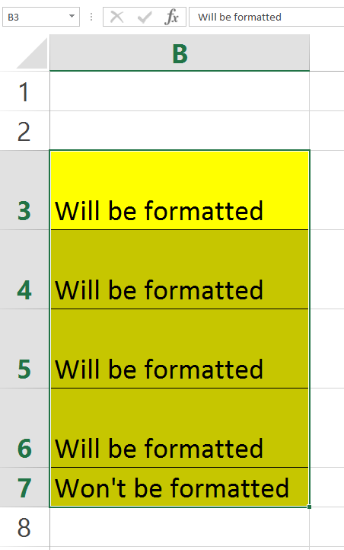
Borders and Shading
Add some pizazz to any cell or range

Slide 72
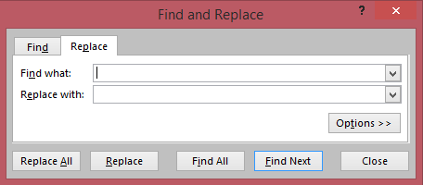
Find and Replace
[CTRL] and [F]
Look for text, and replace with other items
Options button gives you advanced features

Slide 73
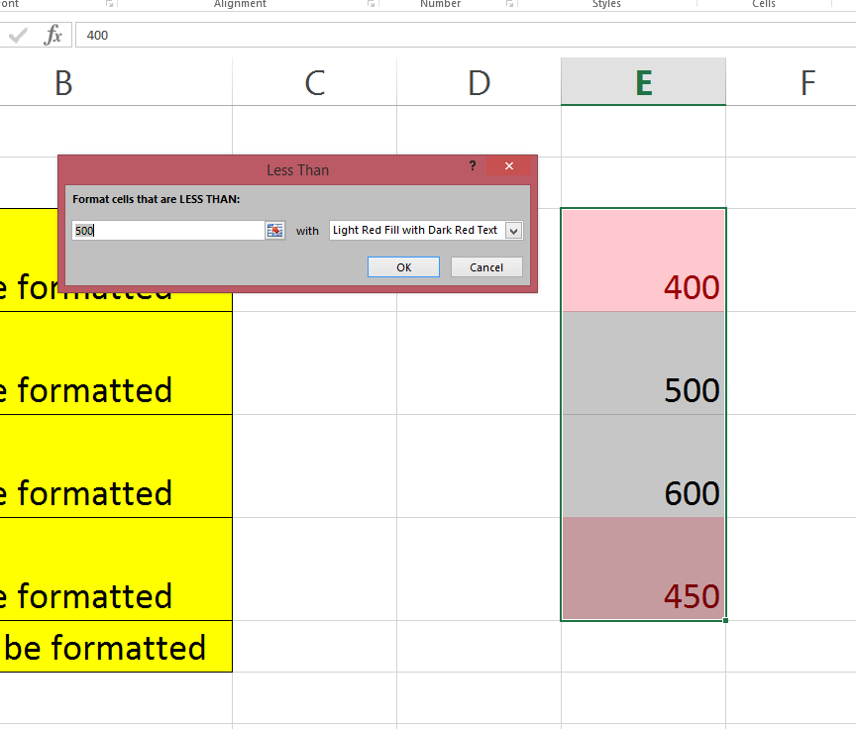
Conditional Formatting
Allows you to visually show differences in
numbers, highs, lows, patterns
Located on the home tab

Slide 74
Class 6:
Read chapter 6
Group exercise
Review of formatting (Probably 10 minutes)
Charting for EX04.2 and EX05.2
  Chart types 6.4
  Data sources 6.3
  Placement 6.3
  Labelling 6.4 and 6.5
  Moving, sizing, deleting charts 6.8
  Other charts (Line, Pie, Etc.)
  Editing chart 6.13 and 6.16
  Layouts, Trendlines, Sparklines 6.20-.24
Maybe a little quiz. Not sure.

Slide 75
Class 6: Charts and Graphs
Review
  IF( ) statement
  VLOOKUP( )
Other cool formulae:
  Concatenate( )
  Trim( )
  Count and CountA( )
  SumIF( ), CountIf( ), AverageIF( )
Charts and Graphs
Break
Test Preview
CHARTS

Slide 77
Group Projects
Team Sunset: Budget spreadsheet for Cancun
Team Da Bronx: Budget spreadsheet for trip to Hawaii
Team Da Row: Movie Production Company Budget
Remember:
  Has to include everyone in the group
  Has to include at least 3 different functions or formulas
  It must look pretty (Formatting, not a new hairstyle)

Slide 78
Nick Knacks
Borders and Shading review
Printing spreadsheets review
Protecting spreadsheets
Freezing panes
Sorting and filtering
Cookies?

Slide 79
Protecting Spreadsheets
Protect entire spreadsheet, or parts of it
Most important thing is to protect the formulas
Two step process:
Highlight the cells that you want to be able to still change after protection
[Home] >> (next to number tab)
Go to [Protection] tab
Unlock cells by unchecking “Locked”, hit [ok]
Then, go to [Review] >> Protect Sheet
Make sure cells that are locked / unlocked can still be selected.

Slide 80
THANK YOU
FOR PARTICIPATING!
~ Tom

